Slide 1
JUMP TO JADE
PROMOTIONt

Slide 2
Accumulate new PGV +
Advance in rank to Jade Executive
PROMOTION STARTS
11:59 p.m. ET 31 Mar. 2020
Earn a bonus, plus commissions!
PROMOTION ENDS
11:59 p.m. ET 30 April 2020

Slide 3
EARN A BONUS THIS MONTH WITH THE
RANK | PGV | BONUS
Jade Executive | 600 | $175
RANK UP TO JADE EXECUTIVE
Executives or below who advance in rank to Jade Executive and accumulate 600 PGV during the promotional period can earn a $175 USD bonus,
plus commissions.

Slide 4
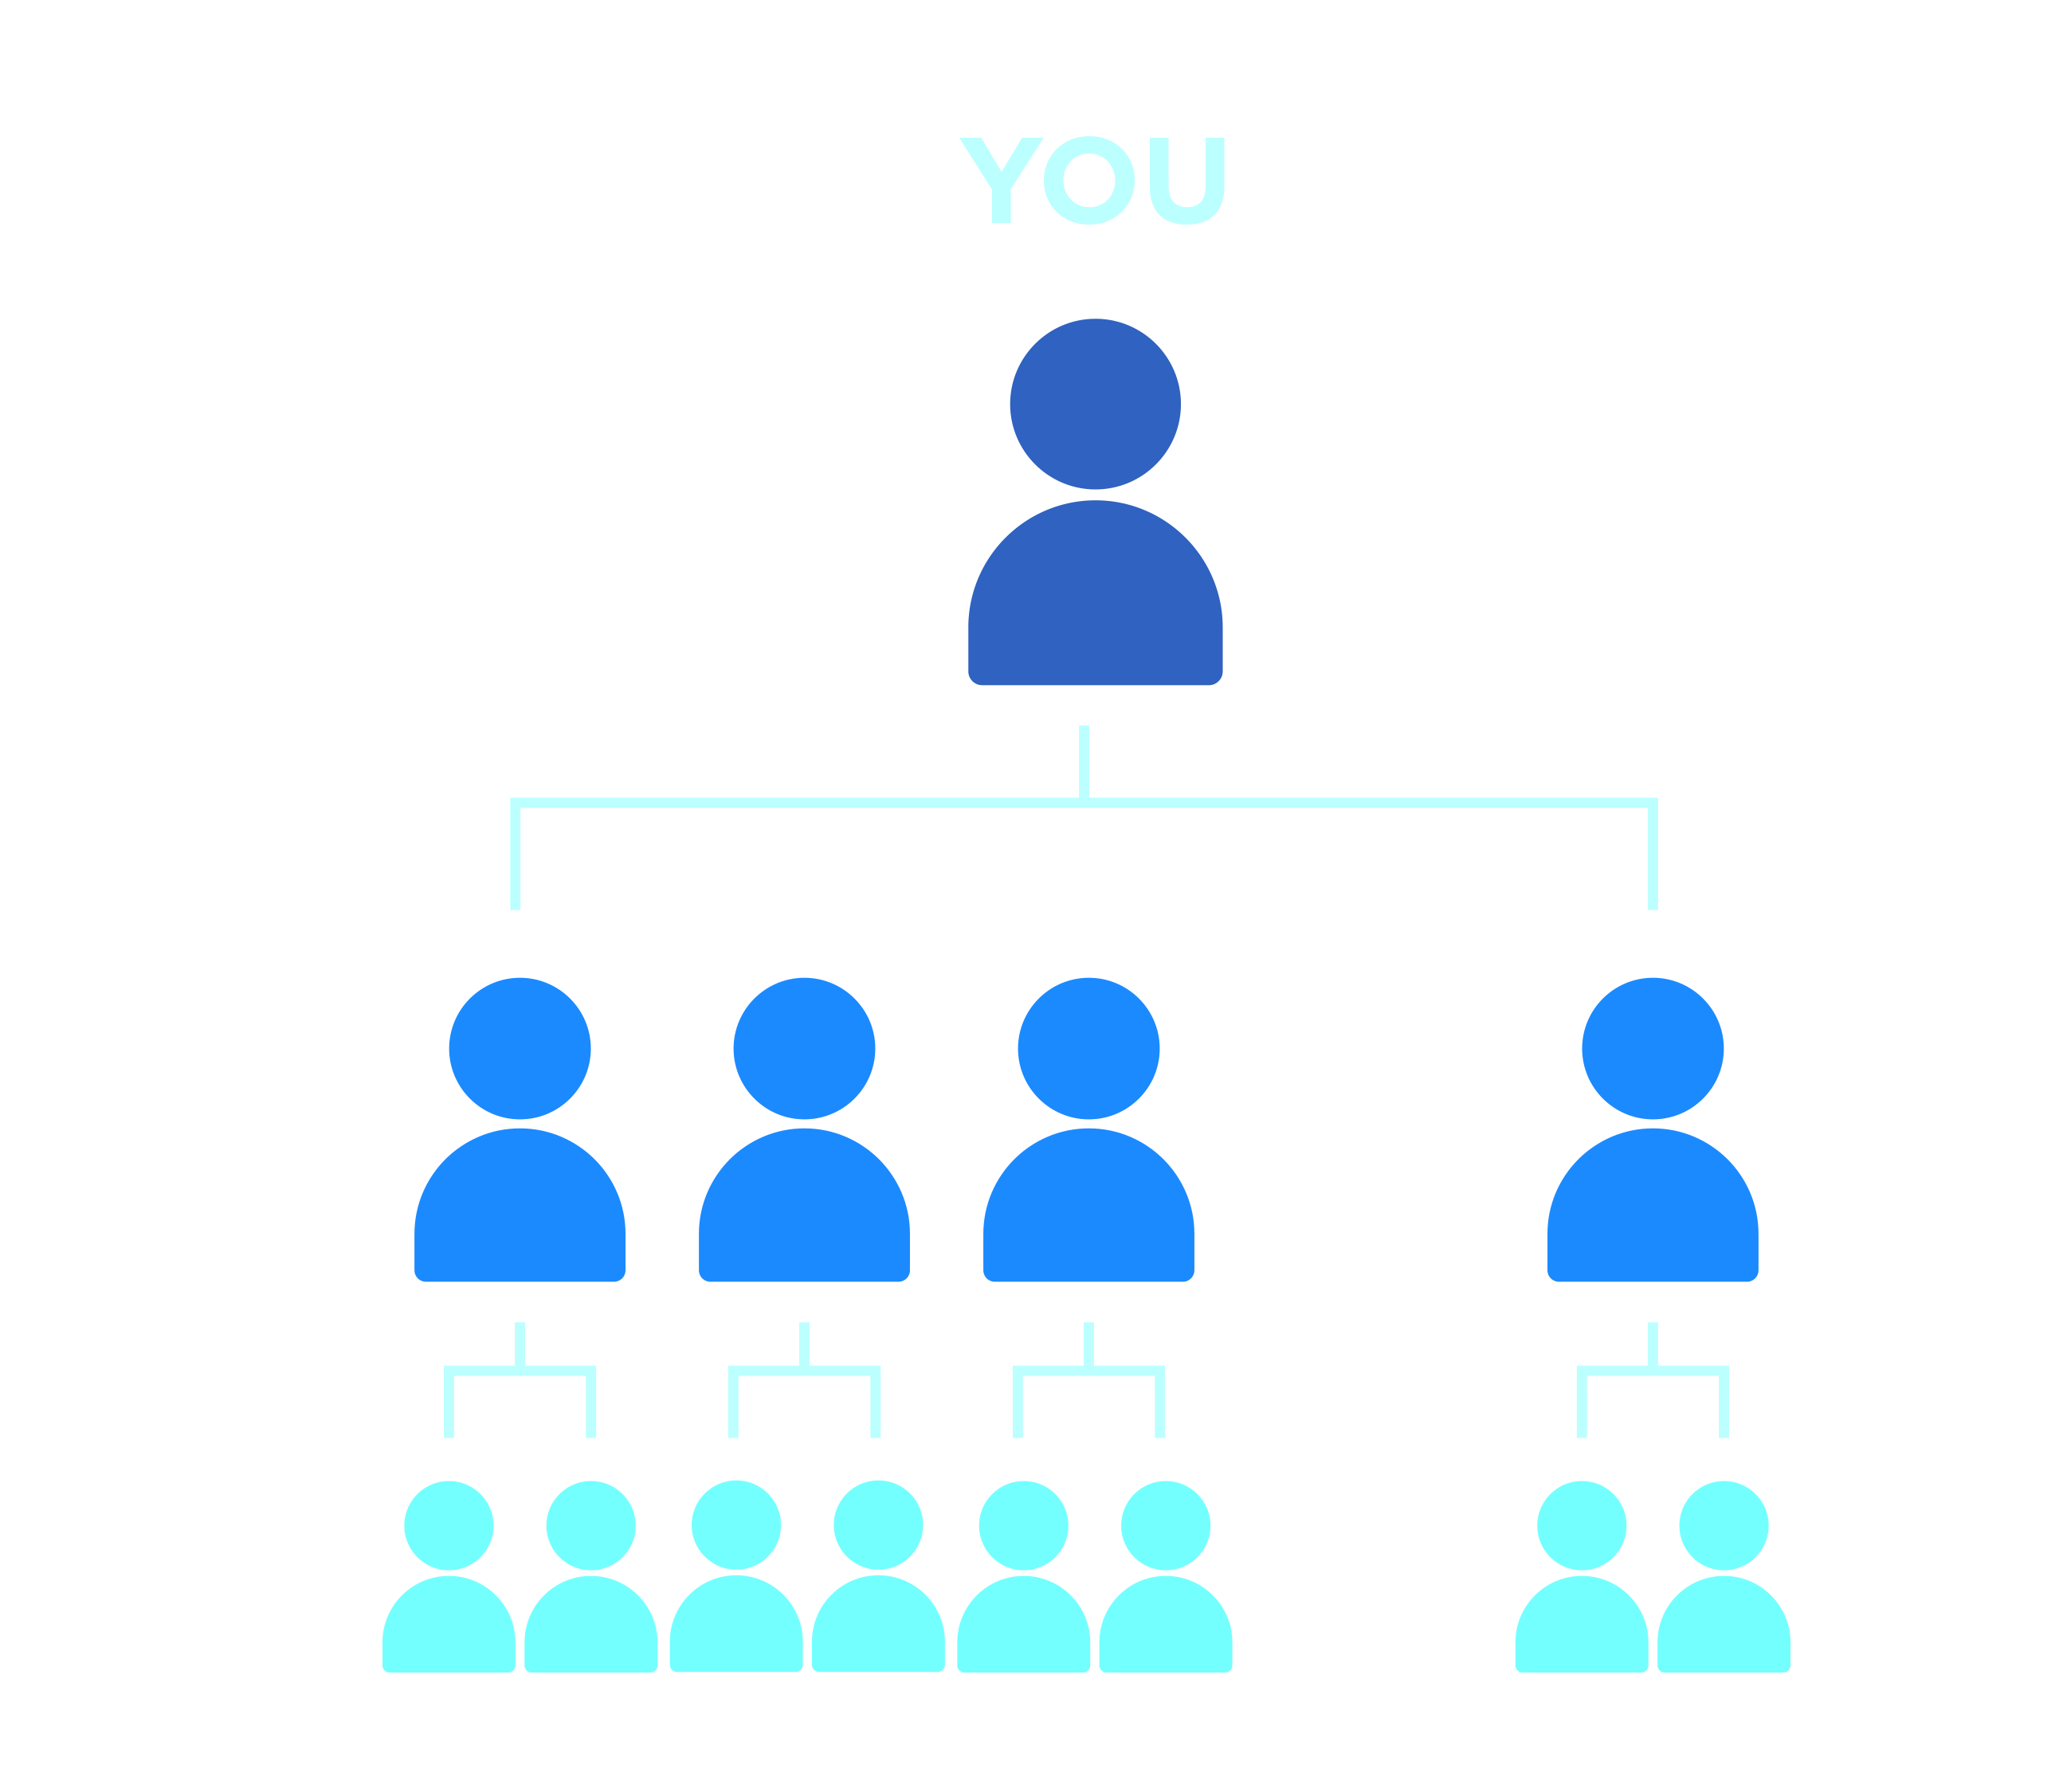
RANK UP to REAL JADE
EXECUTIVE
To achieve the rank of Jade Executive, you must have:
4 personally sponsored Executives (min. 1 each team)
8 personally sponsored Distributors (min. 3 each team)
ACCUMULATE 600 PGV
=
$175 USD BONUS

Slide 5
IMPORTANT INFORMATION
PGV is cumulative. Starting rank is based on “paid as” rank at 11:59 p.m. ET 31 Mar. 2020; purchased ranks do not qualify. Existing members will be allowed to earn a bonus on the requalification of a rank. All PGV must be new and earned within the promotional period.
Achievers earn only one bonus during the promotional period.
Eligible PGV is accrued through new sales from personally enrolled Distributors. Points from monthly SmartDelivery orders exceeding the 60 CV monthly qualifier will count for uplines, not the buyer.
All PGV from Customers and Jeunesse Preferred Customers counts toward qualified PGV for uplines; not the Sponsor.
All sales must be real and driven by bona fide product purchases by end users, either to Customers or new Distributors. Any falsified activity which qualifies a Distributor for a promotion is considered Gaming/Bonus Buying and is not allowed. This activity will disqualify the Distributor from the promotion and is grounds for termination of their Distributorship. See the Policies & Procedures for further details.

Slide 6
PROMOTION RULES
No more than 35% of the volume can come from any one leg.
Any bonuses and PGV will be withdrawn or offset where CV is retracted due to product returns and cancelations, per section 7.5 of the Policies & Procedures.
For the purpose of this promotion, Personal Group Volume (PGV) is defined as follows: (1) volume that is generated throughout your organization, excluding volume created by your upline (spillover).
PGV must be “non-blocked” volume, which is best described by the following example: If you are a Pearl Executive working toward achieving the rank of Sapphire Executive during the promotional period, and you have a personally sponsored Pearl Executive in your downline also working toward achieving the rank of Sapphire Executive during the promotion, you may count the PGV generated by your personally sponsored Pearl Executive only until they achieve the rank of Sapphire Executive. All volume they generate after they reach Sapphire Executive would be excluded from your qualifying PGV (the same holds true for the other ranks).
“Blocking” is only applicable for the promotion, and does not apply to the Jeunesse Financial Rewards Plan.
PGV is cumulative during the promotional period. Bonuses will be paid out in 4-6 weeks, once the promotion ends.
A “paid as” rank is defined as the rank you are currently being paid as (not purchased through packages).

Slide 7
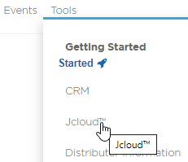
TOOLS
Email announcement
Joffice™ report
Training PowerPoint
Infographic
Overview & FAQs
All promotion tools can be found in Jcloud, located in Joffice, under Tools.

Slide 8
NEXT STEPS
Visit www.JeunesseGlobal.com and log in to your Joffice/Jcloud
Review the tools in the Jump to Jade file​
Check Joffice under Distributor Reports, for promotion information​
Promote Jump to Jade on your next call, webinar or meeting throughout​ the promotion
​
Drive hard to close this promotion
Lead your team by setting the pace to qualify for a Jump to Jade bonus

Slide 9
JUMP TO JADE
PROMOTIONt

