Slide 1
May & June 2020

Slide 2
EARN ONE BONUS UP TO
$20,000 USD
WORLDWIDE PROMOTIONAL PERIOD
11:59 p.m. ET April 30, 2020 to 11:59 p.m. ET June 30, 2020
Executive
250 PGV
$75 USD
Jade
Executive
750 PGV
$200 USD
Pearl
Executive
2,500 PGV
$800 USD
Sapphire
Executive
4,500 PGV
$1,500 USD
Sapphire 25
Executive
10,000 PGV
$3,000 USD
Sapphire 50
Executive
15,000 PGV
$4,000 USD
Sapphire Elite
Executive
25,000 PGV
$6,000 USD
Ruby
Director
75,000 PGV
$10,000 USD
Emerald
Director
175,000 PGV
$15,000 USD
Diamond
Director
350,000 PGV
$20,000 USD
See promotion overview and FAQs for more details.

Slide 3
EARN ONE BONUS FROM EXECUTIVE TO DIAMOND DIRECTOR
4
3
ACHIEVE SAPPHIRE EXECUTIVE
ACCUMULATE 4,500 PGV
2
ACHIEVE PEARL EXECUTIVE
ACCUMULATE 2,500 PGV
1
ACHIEVE JADE EXECUTIVE
ACCUMULATE 750 PGV
$1,500 USD
ACHIEVE EXECUTIVE
ACCUMULATE 250 PGV
$800 USD
UNLOCK
THIRD MATCHING BONUS LEVEL
$200 USD
UNLOCK
SECOND MATCHING
BONUS LEVEL
$75 USD
UNLOCK
FIRST MATCHING BONUS LEVEL

Slide 4
EARN ONE BONUS FROM EXECUTIVE TO DIAMOND DIRECTOR
7
6
ACHIEVE SAPPHIRE ELITE EXECUTIVE
EARN 100 CYCLES
ACCUMULATE 25,000 PGV
ACHIEVE SAPPHIRE 50 EXECUTIVE
EARN 50 CYCLES
ACCUMULATE 15,000 PGV
5
ACHIEVE SAPPHIRE 25 EXECUTIVE
EARN 25 CYCLES
ACCUMULATE 10,000 PGV
$6,000* USD
$4,000* USD
UNLOCK
THIRD MATCHING BONUS LEVEL
$3,000 USD
UNLOCK
THIRD MATCHING BONUS LEVEL
UNLOCK
THIRD MATCHING
BONUS LEVEL
*50% bonus: If you have participated in any previous Jeunesse promotion within the past two years and have earned $6,000 USD or more
(as a new Sapphire Executive or higher), as a requalification you can receive 50% of the qualifying bonus for Sapphire 50 Executive or above.

Slide 5
EARN ONE BONUS FROM EXECUTIVE TO DIAMOND DIRECTOR
7
6
ACHIEVE DIAMOND DIRECTOR
ACCUMULATE 350,000 PGV
ACHIEVE EMERALD DIRECTOR
ACCUMULATE 175,000 PGV
5
ACHIEVE RUBY DIRECTOR
ACCUMULATE 75,000 PGV
$20,000* USD
$15,000* USD
UNLOCK
SIXTH MATCHING BONUS LEVEL
$10,000* USD
UNLOCK
FIFTH MATCHING BONUS LEVEL
UNLOCK
FOURTH MATCHING
BONUS LEVEL
*50% bonus: If you have participated in any previous Jeunesse promotion within the past two years and have earned $6,000 USD or more
(as a new Sapphire Executive or higher), as a requalification you can receive 50% of the qualifying bonus for Sapphire 50 Executive or above.

Slide 6
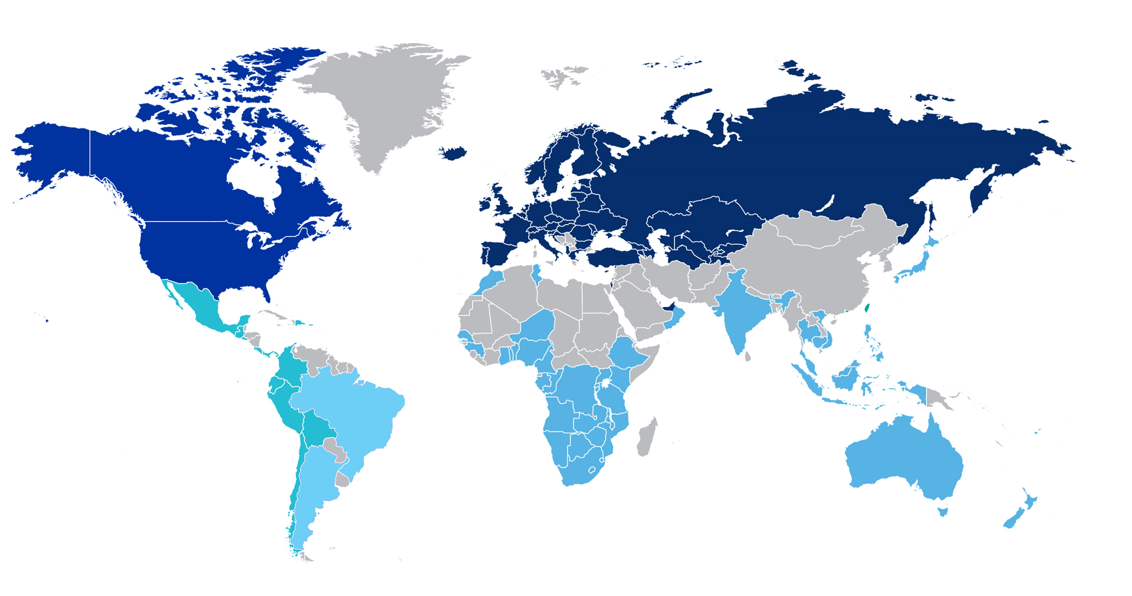
Diamond Vision Worldwide Promotion
11:59 p.m. ET 30 April 2020 to 11:59 p.m. ET 30 June 2020
NORTH AMERICA
EUROPE &
MIDDLE EAST
GREATER
CHINA
LATIN AMERICA
BRAZIL
ASIA PACIFIC
& AFRICA
ARGENTINA
May and June 2020

Slide 7
“Paid As” Rank Regardless of your highest achieved rank, you may start at the rank at which you are currently paid, or your “paid as” rank | Monthly Timeframe to Achieve Bonuses in 2020 | Cumulative New PGV | Full Bonus for New Ranks | Partial Bonuses for Requalification
Executive | May & June | 250 | $75 USD | Full Bonus
Jade Executive | May & June | 750 | $200 USD | Full Bonus
Pearl Executive | May & June | 2,500 | $800 USD | Full Bonus
Sapphire Executive | May & June | 4,500 | $1,500 USD | Full Bonus
Sapphire 25 Executive | May & June | 10,000 | $3,000 USD | Full Bonus
Sapphire 50 Executive | May & June | 15,000 | $4,000 USD | $2,000 USD
Sapphire Elite Executive | May & June | 25,000 | $6,000 USD | $3,000 USD
Promotion requirements and payout: Distributors can earn the highest bonus during the promotion qualification period by advancing in rank and acquiring new Personal Group Volume. See rules for more information.
*50% bonus: If you have participated in any previous Jeunesse promotion within the last two years and have earned $6,000 USD or more (as a new Sapphire Executive or higher), as a requalification you can receive 50% of the qualifying bonus for Sapphire 50 Executive or above.

Slide 8
“Paid As” Rank Regardless of your highest achieved rank, you may start at the rank at which you are currently paid, or your “paid as” rank | Monthly Timeframe to Achieve Bonuses in 2020 | Cumulative New PGV | Full Bonus for New Ranks | Partial Bonuses for Requalification
Ruby Director | May & June | 75,000 | $10,000 USD | $5,000 USD
Emerald Director | May & June | 175,000 | $15,000 USD | $7,500 USD
Diamond Director | May & June | 350,000 | $20,000 USD | $10,000 USD
Promotion requirements and payout: Distributors can earn the highest bonus during the promotion qualification period by advancing in rank and acquiring new Personal Group Volume. See rules for more information.
*50% bonus: If you have participated in any previous Jeunesse promotion within the last two years and have earned $6,000 USD or more (as a new Sapphire Executive or higher), as a requalification you can receive 50% of the qualifying bonus for Sapphire 50 Executive or above.

Slide 9
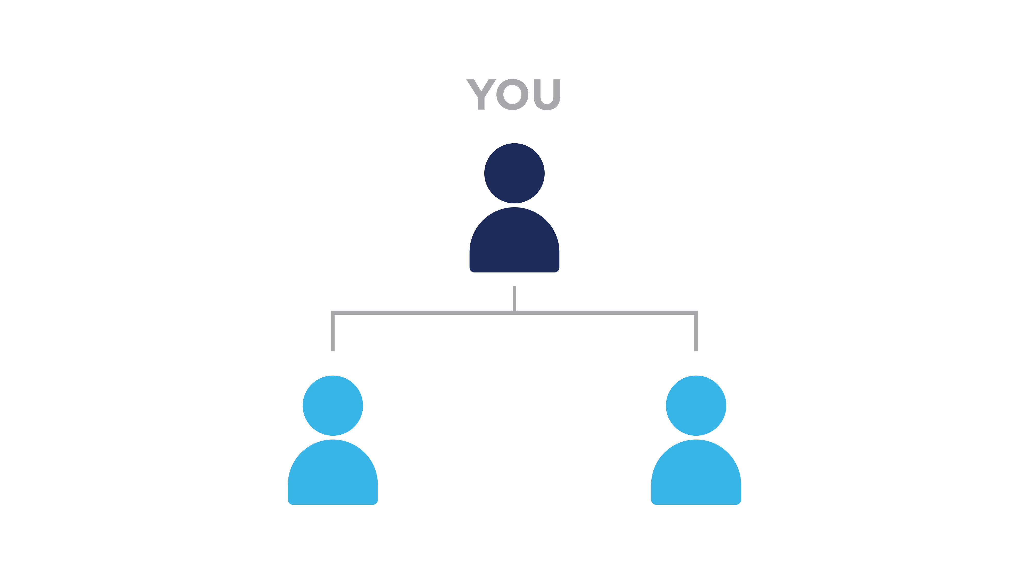
ACHIEVE EXECUTIVE RANK
AND ACCUMULATE 250 PGV
TO EARN A $75 USD BONUS
To achieve the rank of Executive, you must be active (60 PV) and qualified.
(Two personally sponsored, active Distributors – one on your left team and one on your right team.)

Slide 10
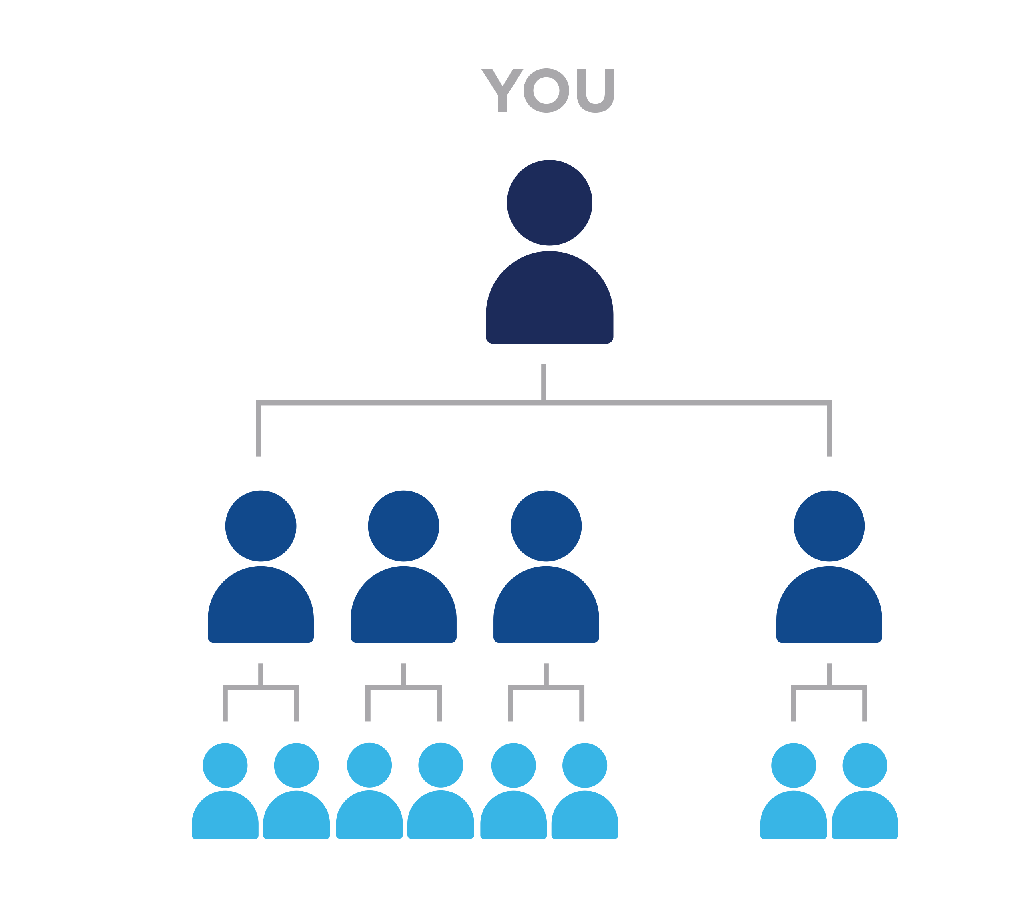
ACHIEVE JADE EXECUTIVE RANK
AND ACCUMULATE 750 PGV
TO EARN A $200 USD BONUS
To achieve the rank of Jade Executive, you must have:
4 personally sponsored Executives
(min. 1 each team*)
OR
8 personally sponsored Distributors (min. 3 each team*)
*Canada and India Distributors:
See Financial Rewards Plan

Slide 11
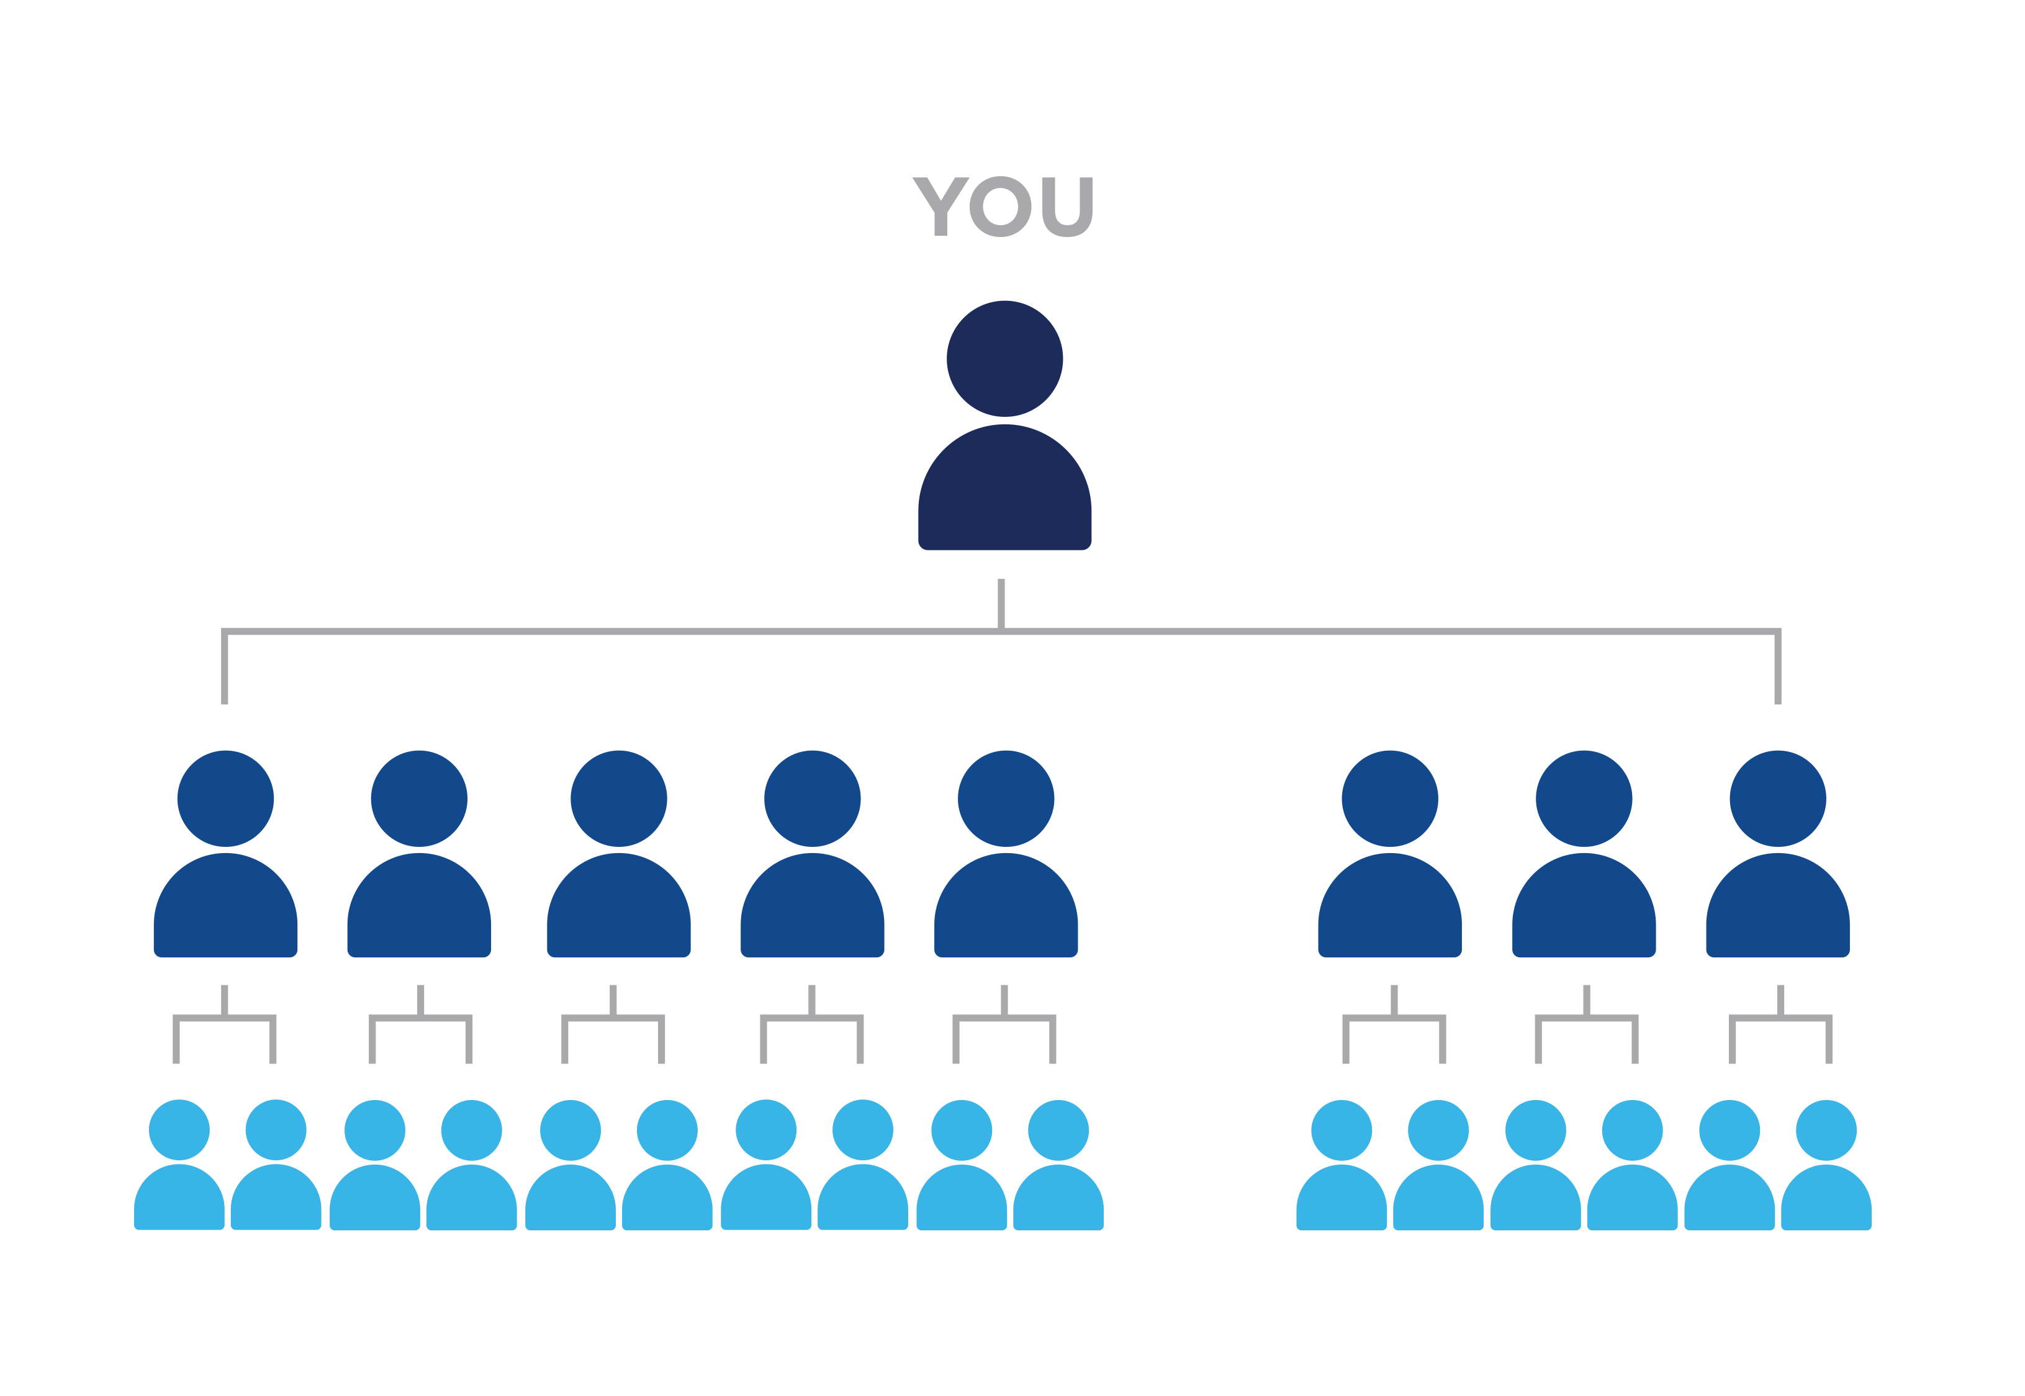
ACHIEVE PEARL EXECUTIVE RANK
AND ACCUMULATE 2,500 PGV
TO EARN A $800 USD BONUS
To achieve the rank of Pearl Executive, you must have:
8 personally sponsored Executives (min. 2 each team*)
OR
12 personally sponsored Distributors (min. 3 each team*)
*Canada and India Distributors:
See Financial Rewards Plan

Slide 12
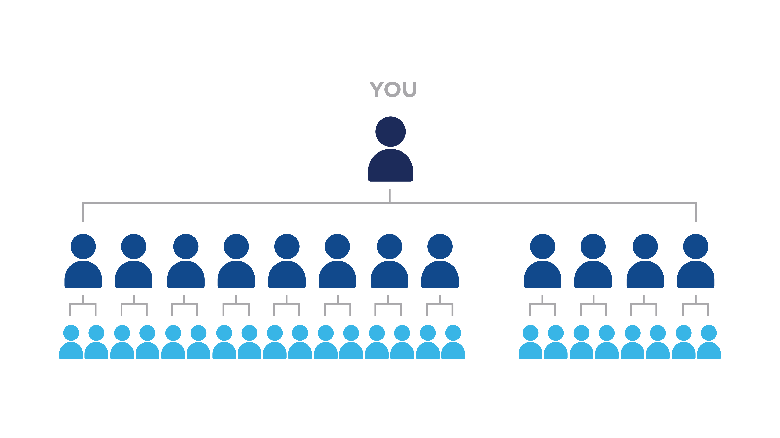
ACHIEVE SAPPHIRE EXECUTIVE RANK
AND ACCUMULATE 4,500 PGV
TO EARN A $1,500 USD BONUS
To achieve the rank of Sapphire Executive, you must have:
12 personally sponsored Executives (min. 3 each team*)
*Canada and India Distributors:
See Financial Rewards Plan

Slide 13
ACHIEVE SAPPHIRE 25 EXECUTIVE RANK
AND ACCUMULATE 10,000 PGV
TO EARN A $3,000 USD BONUS
To achieve the rank of Sapphire 25 Executive, you must have:
12 personally sponsored Executives
(min. 3 each team*)
AND
25 team cycles in the preceding month
*Canada and India Distributors:
See Financial Rewards Plan
**Note 50% payout may apply

Slide 14
ACHIEVE SAPPHIRE 50 EXECUTIVE RANK
AND ACCUMULATE 15,000 PGV
TO EARN A $4,000 USD BONUS**
To achieve the rank of Sapphire 50 Executive, you must have:
12 personally sponsored Executives (min. 3 each team*)
AND
50 team cycles in the preceding month
*Canada and India Distributors:
See Financial Rewards Plan
**Note 50% payout may apply

Slide 15
ACHIEVE SAPPHIRE ELITE EXECUTIVE RANK
AND ACCUMULATE 25,000 PGV
TO EARN A $6,000 USD BONUS**
To achieve the rank of Sapphire Elite Executive, you must have:
12 personally sponsored Executives (min. 3 each team*)
AND
100 team cycles in the preceding month
*Canada and India Distributors:
See Financial Rewards Plan
**Note 50% payout may apply

Slide 16
ACHIEVE RUBY DIRECTOR RANK
AND ACCUMULATE 75,000 PGV
TO EARN A $10,000 USD BONUS**
To achieve the rank of Ruby Director rank, you must have:
Been paid as a Sapphire Executive with at least two teams that have Distributors paid at the rank of Sapphire Executive
AND
200 team cycles in the preceding month
*Canada and India Distributors:
See Financial Rewards Plan
**Note 50% payout may apply

Slide 17
ACHIEVE EMERALD DIRECTOR RANK
AND ACCUMULATE 175,000 PGV
TO EARN A $15,000 USD BONUS**
To achieve the rank of Emerald Director, you must have:
Been paid as a Sapphire Executive with at least four teams that have Distributors paid at the rank of Sapphire Executive
AND
500 team cycles in the preceding month
*Canada and India Distributors:
See Financial Rewards Plan
**Note 50% payout may apply

Slide 18
ACHIEVE DIAMOND DIRECTOR RANK
AND ACCUMULATE 350,000 PGV
TO EARN A $20,000 USD BONUS**
To achieve the rank of Diamond Director, you must have:
Been paid as a Sapphire Executive with at least six teams that have Distributors paid at the rank of Sapphire Executive
AND
1,000 team cycles in the preceding month
AND
1,000 team cycles in the current month
*Canada and India Distributors:
See Financial Rewards Plan
**Note 50% payout may apply

Slide 19
IMPORTANT
!
INFORMATION
You must be active (as defined in the Financial Rewards Plan) and in good standing (no open compliance issues) with Jeunesse to participate in this promotion.
All participants in the Diamond Vision promotion will begin at their current “paid as” rank as of 11:59 p.m. ET April 30, 2020.
What is PGV?
Personal Group Volume is the CV generated throughout your lines of sponsorship. It does not include spillover volume.
Is PGV cumulative for this promotion?
Yes, PGV is cumulative for this promotion. For example: If a Distributor achieves Executive with 375 qualified PGV, they would only need an additional 375 PGV while achieving Jade Executive to earn the $200 USD Jade Executive bonus. For rank qualifications, please see the Financial Rewards Plan.
What is “new PGV”?
New PGV is defined as PGV accrued during the promotional period of April 30, 2020-June 30, 2020.
What is “paid as” rank?
The “paid as” rank is the rank at which an existing Distributor is “paid as” as of 11:59 p.m. ET April 30, 2020 and must have been earned by building an organization and accruing the required volume, and not achieved by purchasing a package.

Slide 20
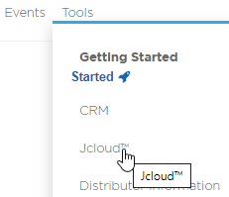
TOOLS
Email announcement
Joffice™ report
Training PowerPoint
Infographic
Overview & FAQs
All promotion tools can be found in Jcloud, located in Joffice, under Tools.

Slide 21
NEXT STEPS
Visit www.JeunesseGlobal.com and log in to Joffice/Jcloud™
Review the tools in the “Diamond Vision” file​
Check your Joffice report under “Distributor Reports” for promotion information​
Promote Diamond Vision on your next call, webinar or meeting through May and June
Drive hard to close this promotion
Lead your team by setting the pace to qualify for a Diamond Vision bonus

Slide 22
©2020 Jeunesse Global Holdings, LLC. All Rights Reserved. Published 04142020 Jeunesse and fountain logo are trademarks of Jeunesse Global Holdings, LLC

