Slide 1




Slide 2




Slide 4


Slide 5
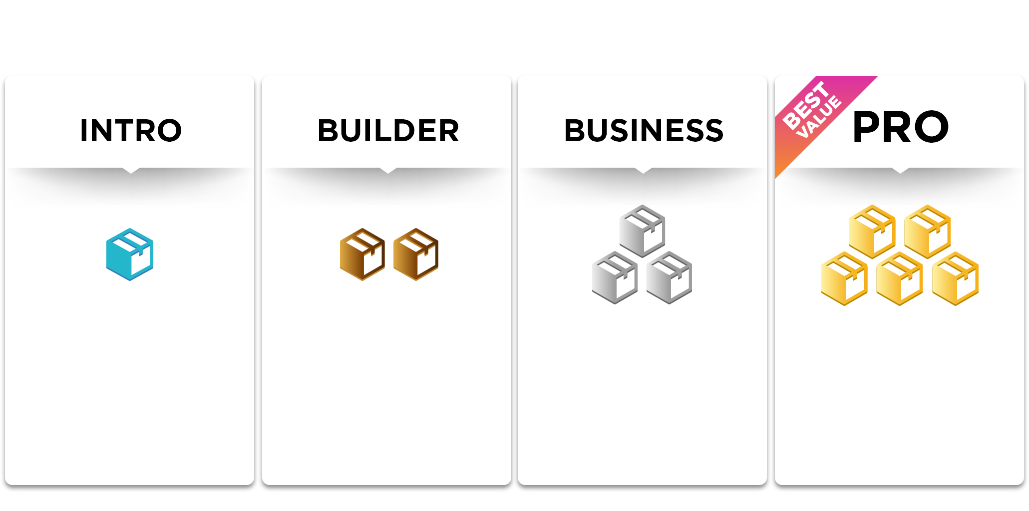

100 CV
300 CV
600 CV
900 CV

Slide 7
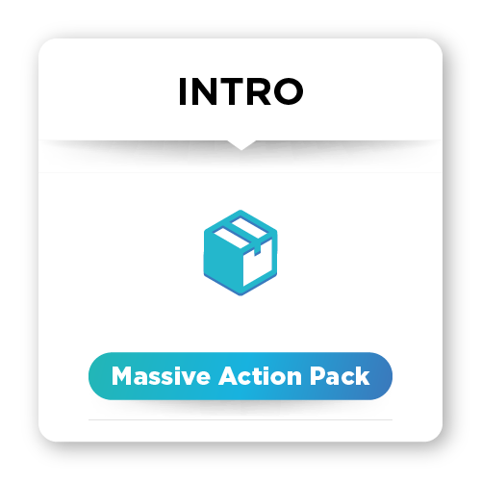
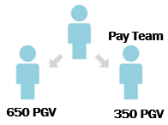
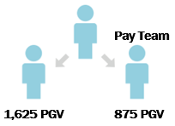
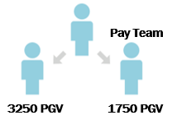
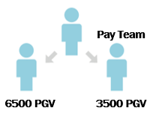
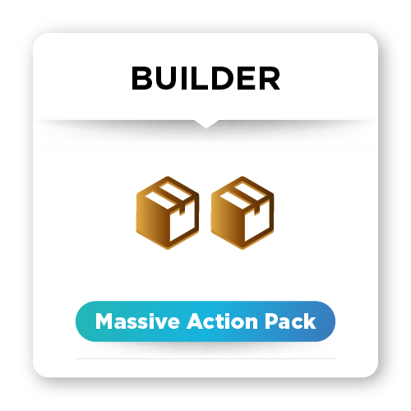

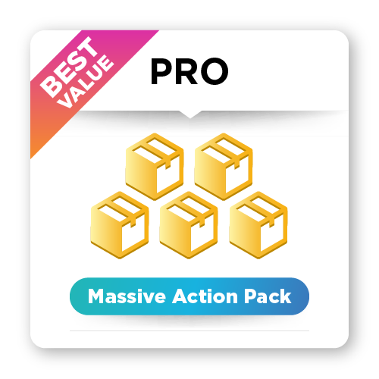
1,000 PGV | 2,500 PGV | 5,000 PGV | $310,000 PGV00
100 CV
$25 | $100 | $200 | $400
300 CV
$100 | $300 | $600 | $1,200
600 CV
$200 | $600 | $1,200 | $2,400
900 CV
$300 | $800 | $1,800 | $3,600

Slide 8

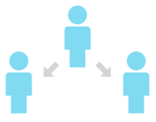
ビルダーパックでの30日間の例
$100
$100
875 PGV
$100
$25
1500
1000
-1200 (600 X 2)
300
1200 PGV
-600 (300 x 2)
400
1500 PGV
300 PGV
1000 PGV
300 PGV
900 PGV
900 PGV

Slide 9


Slide 10
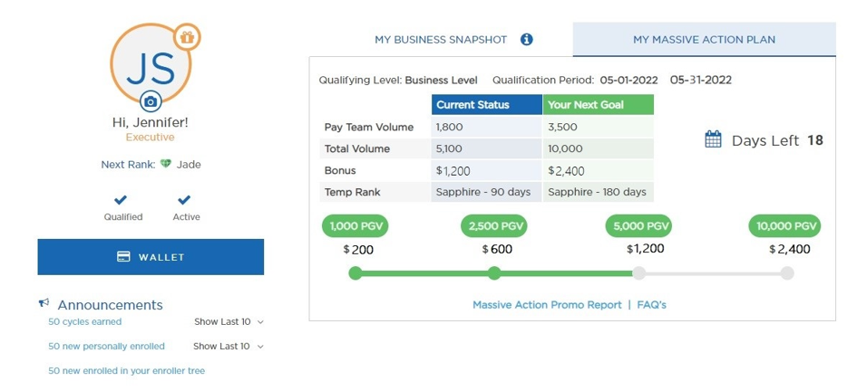

Slide 11


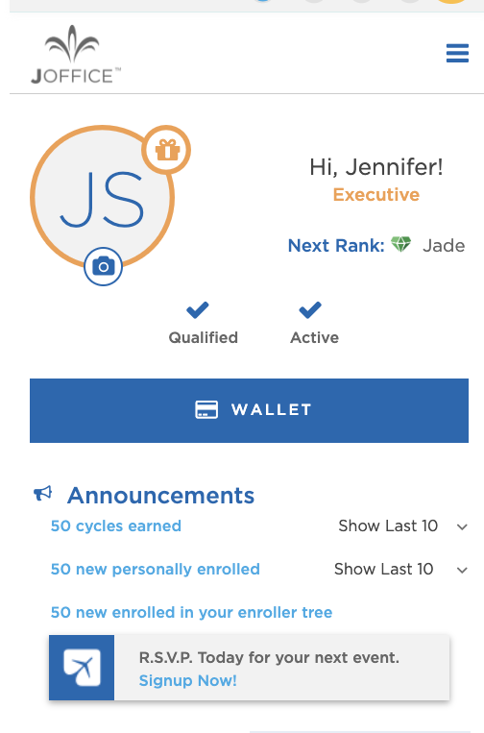
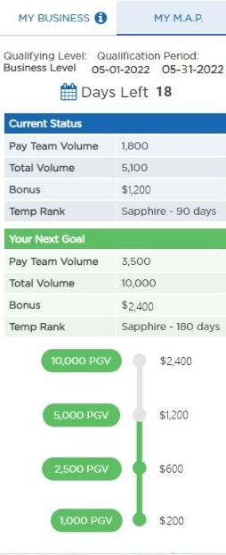

Slide 12
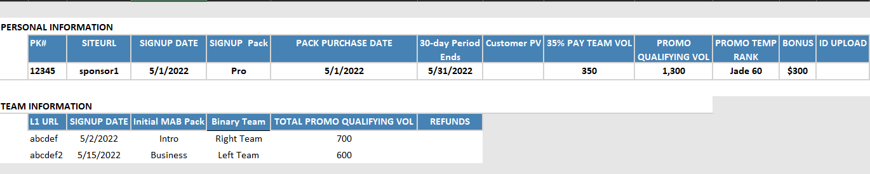
PERSONAL INFORMATION
PK# | SITEURL | SIGNUP DATE | SIGNUP PACK | PACK PURCHASE DATE | 30-DAY PERIOD ENDS | CUSTOMER PV | 30-DAY TEAM VOL | PROMO QUALIFYING VOL | PROMO TEMP RANK | BONUS | ID UPLOAD
12345 | sponsor1 | 5/1/2022 | Pro | 5/1/2022 | 5/31/2022 |  | 350 | 1,300 | Jade 60 | $300
TEAM INFORMATION
L1 URL | SIGNUP DATE | Initial Massive Action Bonus Pack | Binary Team | TOTAL PROMO QUALIFYING VOL | REFUNDS
abcdef | 5/1/2022 | Pro | 5/1/2022 | 5/31/2022

Slide 13
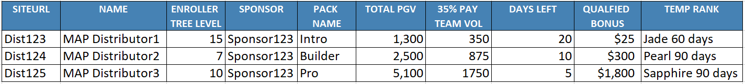
SIREURL | NAME | ENROLLER TREE LEVEL | SPONSOR | PACK NAME | TOTAL PGV | 35% PAY TEAM VOL | DAYS LEFT | QUALIFIED | TEMP RANK
Dist123 | Massive Action Plan Distributor 1 | 15 | Sponsor123 | Intro | 1,300 | 350 | 20 | $25 | Jade Executive 60 days
Dist123 | Massive Action Plan Distributor 2 | 7 | Sponsor123 | Builder | 2,500 | 875 | 10 | $300 | Pearl Executive 90 days
Dist123 | Massive Action Plan Distributor 3 | 10 | Sponsor123 | Pro | 5,100 | 1,750 | 5 | $1,800 | Sapphire Executive 60 days

